Slide 1
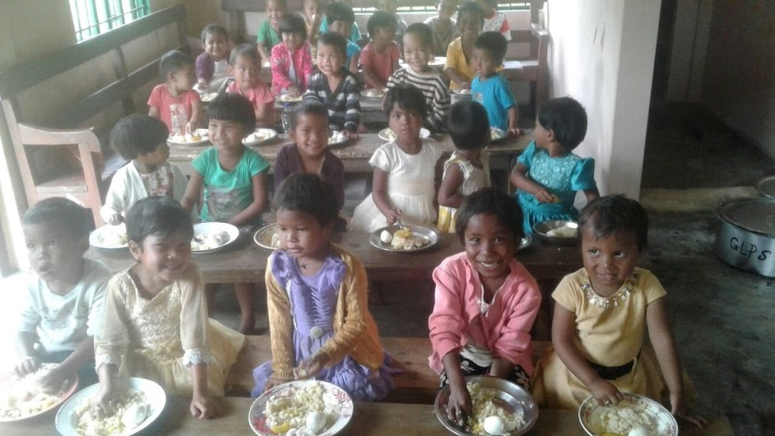
MID DAY MEAL SCHEME MEGHALAYA
Annual Work Plan & Budget
2018-19
Notes:
1

Slide 2
Best Practices
The State Government has established a Corpus Fund amounting to Rs. 10 crores to avoid any delay in releasing of funds to school.
E-Transfer of Mid Day Meal Funds such as Conversion cost and honorarium of Cook-cum-Helpers directly from the State Level to the School’s bank account and Cook-cum-Helper’s personal account respectively.
Community Participations: In some Schools, Parents and community contribute vegetables, fruits, firewood etc. to schools for cooking of meals for the children.
Uses of Tiffin box is being practice in some Government Schools and others schools have been instructed to follow this practice.
Kitchen Garden – Kitchen Garden is been practice in some of the schools in the State. Others Schools have been instructed to follow this practice if land is available for kitchen garden.

Slide 3
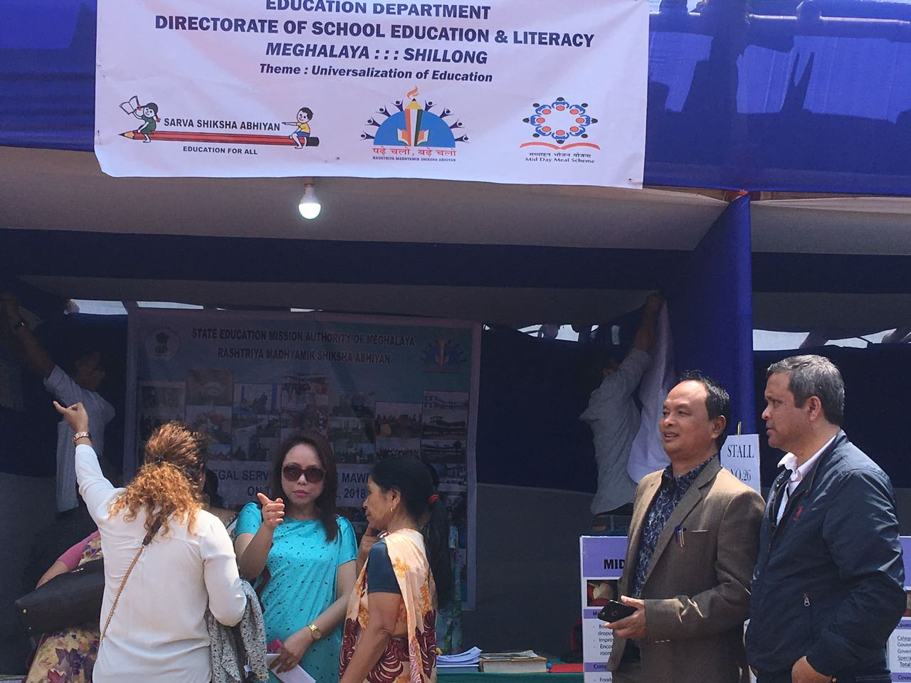
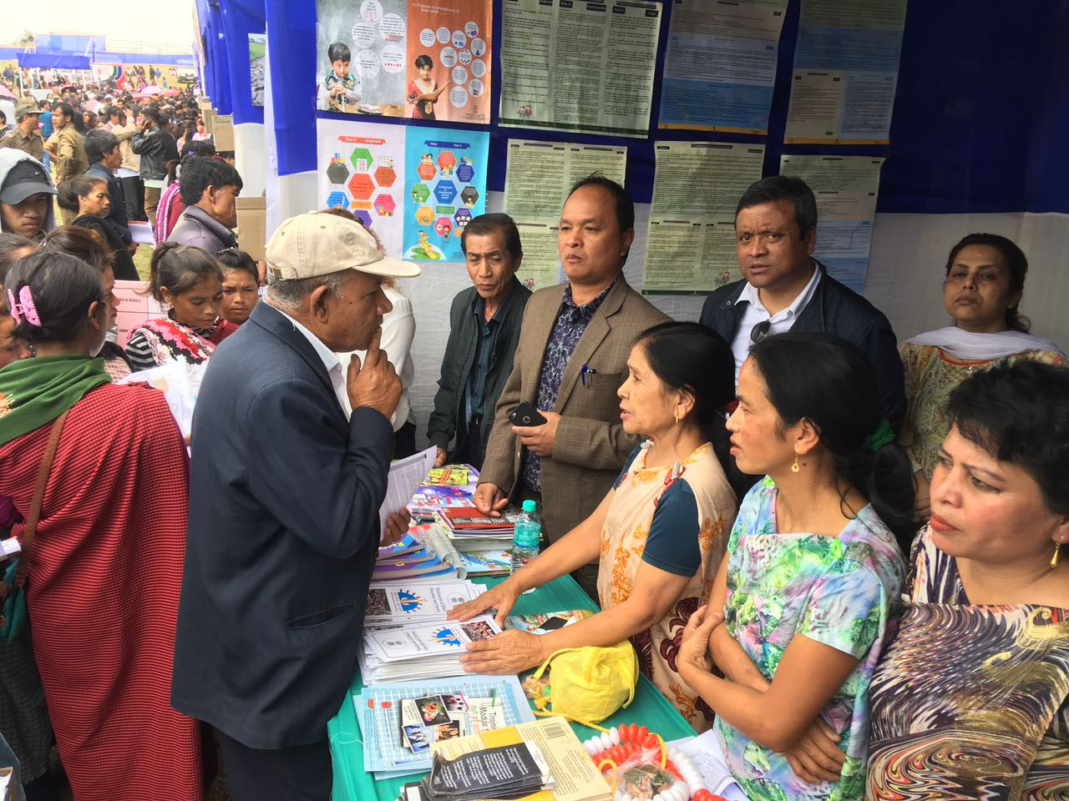
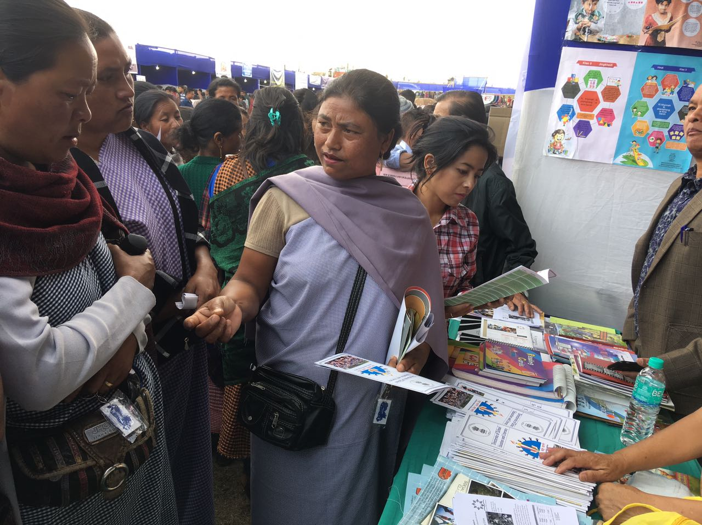
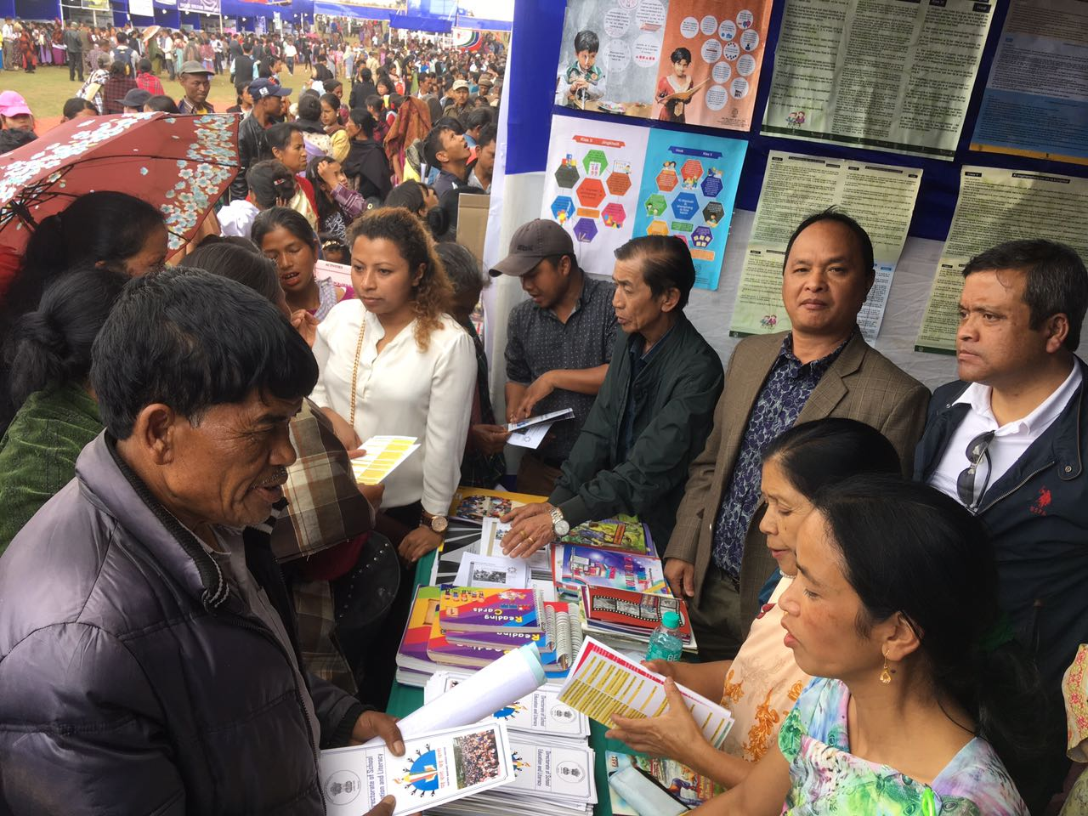
Achievements
Legal Literacy Awareness Camp in collaboration with District Legal Authority of Meghalaya In East Khasi Hills

Slide 4
2. Awareness Programme on NFS Act 2013 under Meghalaya Food Commission have been conducted in the State to all the Headman, Wholesalers/FPS, Head-Teachers, NGOs, etc. in East Khasi Hills, West & South West Khasi Hills, Jaintia Hills, West Garo Hills, East Garo Hills on the implementation of NFS Act under the State for Mid Day Meal Scheme.

Slide 5
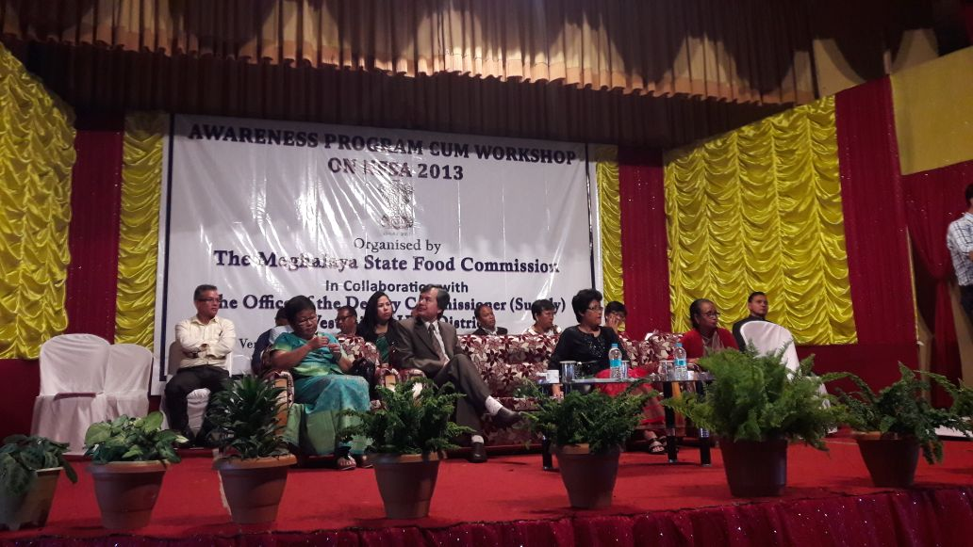
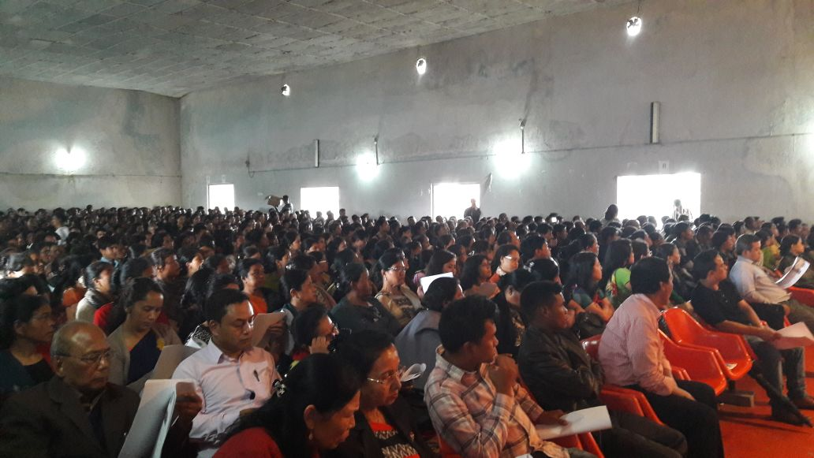
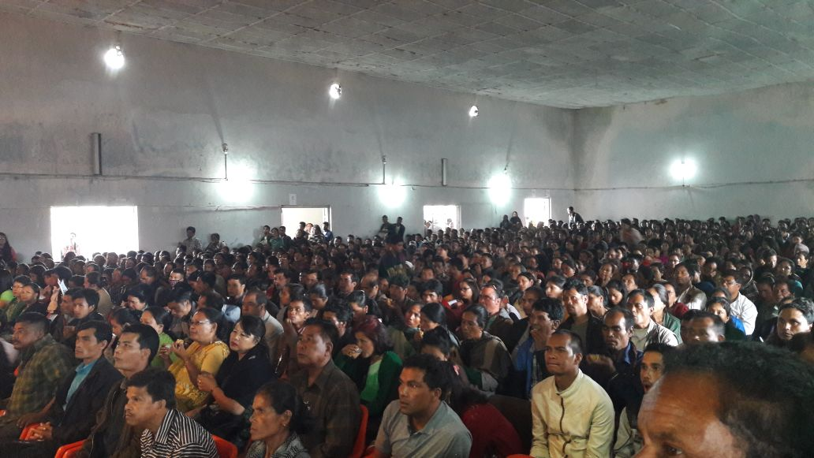

Slide 6
3. A Duty Chart has been notified for the Officers at different Levels to monitor the proper implementation of National Food Security Act 2013 and Mid Day Meals (MDM) Rules 2015 and District Grievance Redressal Cell wth a toll free Number 1967 has been setup to receive complain and addressed the same during office hours.
4. A Contingency Plan & Guidelines to Ensure Quality, Safety And Hygiene To avoid any untoward incidents and for better implementation of MDM for SMCs/ Headmasters/ Headmistress /Head Teachers/Cook-Cum-Helpers have been circulated

Slide 7
5.Social audit has also been carried out on the implementation of Mid Day Meal by the Meghalaya Society For Social Audit & Transparency (MSSAT) Meghalaya, Shillong under the “Meghalaya Community Participation and Public Service Social Audit Act, 2017 (MCP& PSSA) in 18 villages under the Sub Divisions of Shillong, Sohra, Nongpoh, Mairang, Amlarem, Williamnagar, Resubelpara.
6. 100% Payment to FCI in 2017-18.
(FCI Clearance Certificate)

Slide 8
Innovation Plan
In reference to D.O. No. 9-12/2017-EE.6-MDM-3-1 dated 24.5.2017 For fulfilling the objectives of Mid Day Meal Scheme, A New Innovative Project have been formalated by taking inputs/suggestions/plans from State Council of Science, Technology & Environment, Meghalaya and Public Health Engineering (PHE) Department. The Proposal have been submitted to the Joint Secretary (EE-I), Government of India, Ministry of HRD, Department of School Education and Literacy, New Delhi vide letter EDN.NO.351/2009/248 Dated: 19.7.2017 for approval.
The Project covers the following important issues:
Construction of kitchen-cum-stores by using appropriate design to North-Eastern Region.
Coverage of LPG for those Schools in Urban Area where Gas is easily available and Smokeless Chulha for School in rural areas.
Provision of Multi-tap hand washing facilities.
Provision of good drinking water facilities (Two model one for Urban and One for Rural Areas)

Slide 9
Performance During 2017-18

Slide 11
Physical Achievement 2017-18
1.Number of Schools
Category | Total No. of existing Institutions | Coverage | % Vs. Institution
Pry | 8436 | 8207 | 97%
U.Pry | 3411 | 3390 | 99%
Total | 11847 | 11597 | 98%
2. Number of Children
Component | PAB Approval 2017-18 | Enrolment as on 30.9.2017 | Average no. of Children Covered | % Coverage Vrs PAB | % Coverage Vrs Enrolment
Children (Pry) | 385021 | 425555 | 380650 | 98.86% | 89.45%
Children (U.Pry) | 142364 | 173800 | 141780 | 99.59% | 81.58%
Total Children | 527385 | 599355 | 522430 | 99.06% | 87.17%

Slide 12
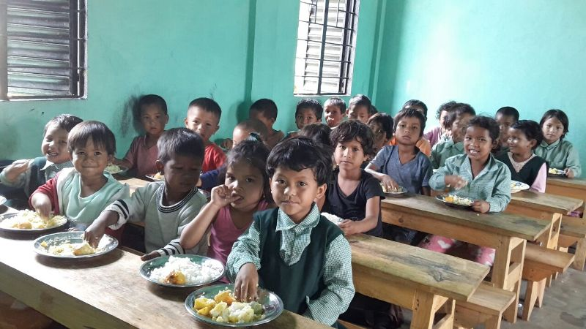

Slide 13
Contd..
3. Cook-Cum-Helpers
Stage | CCH PAB Approval | No. of cooks appointed | Gap Due to frequent Change of CCH | %
2 | 3 | 4 | 5 | 6
Primary | 13579 | 13060 | 519 | 96.18%
U Primary | 4740 | 4740 | 0 | 100.00%
Total | 18319 | 17800 | 519 | 97.17%
4. Foodgrain (In MTs)
Allocation | OB | Lifting | Consumed | Balance | %
12398.43 | 84.96 | 12504.62 | 12205.12 | 384.46 | 98.44%

Slide 14
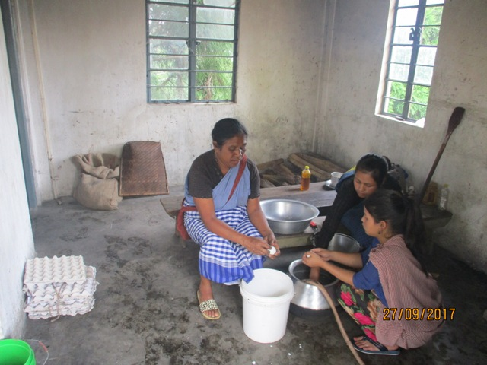

Slide 15
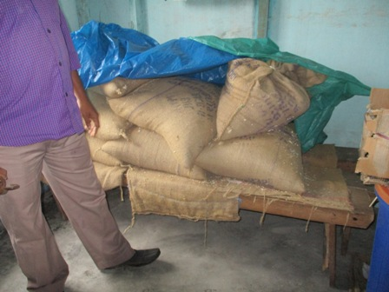
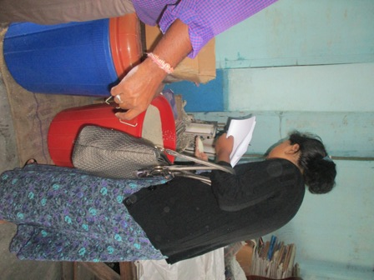

Slide 16
Contd..
5. Construction of Kitchen Sheds
Target (Units Sanctioned) | Constructed | In Progress | Not Started
9491 | 9371 | 120 | 0
N.B:
120 which shows in progress is actually completed but UCs and completion report is awaited from these 120 Schools.
6. Procurement of Kitchen Devices
Years | Target (Units Sanctioned) | Procured | In Progress | Not yet procured
2 | 3 | 4 | 5 | 6
2007-2016 (New) | 12089 | 12089 | 0 | 0
2011-2017 (Replacement) | 8882 | 8882 | 0 | 0

Slide 17
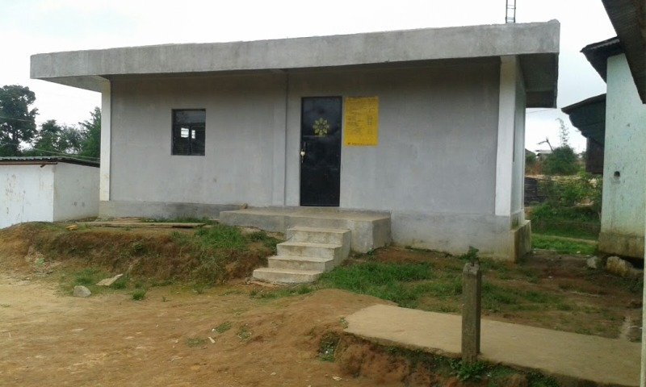
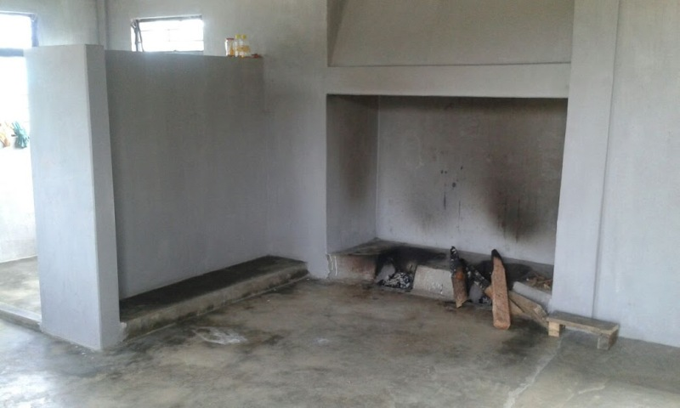
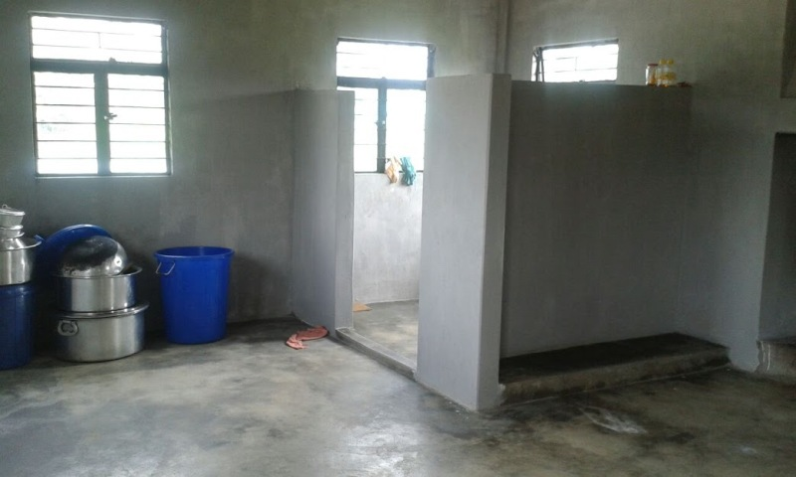

Slide 18
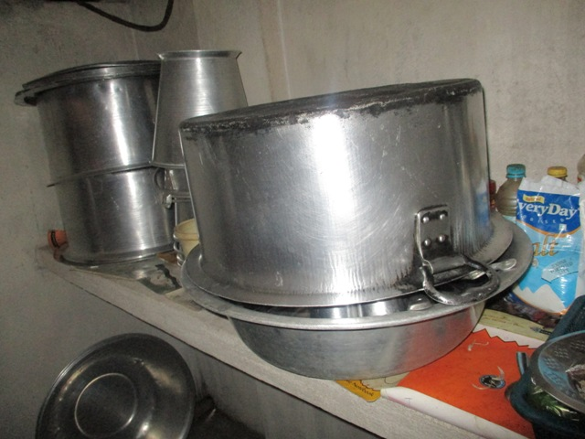
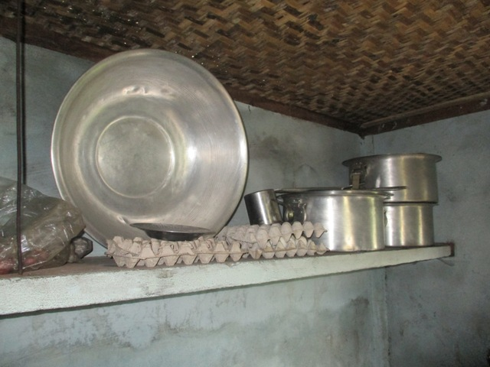

Slide 19
6. School Health Programme (SHP)
Year | Total children to be covered under SHP | Target Total children covered under SHP | % Coverage
2017-18 | 599355 | 431271 | 72%
Year | Weekly Iron & Folic Acid Supplementation (WIFS) | Deworming tablets distributed | Distribution of spectacles
2017-18 | 686840 | 446085 | 4767

Slide 20
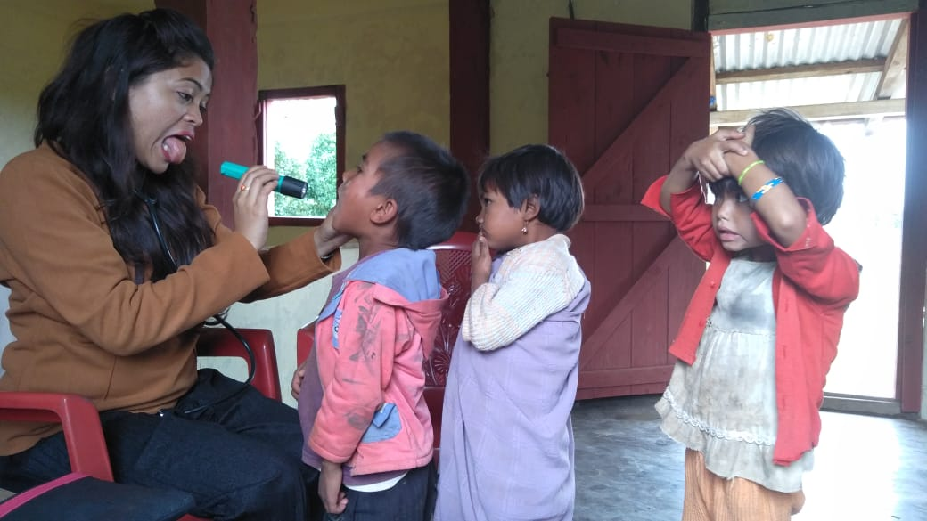

Slide 21
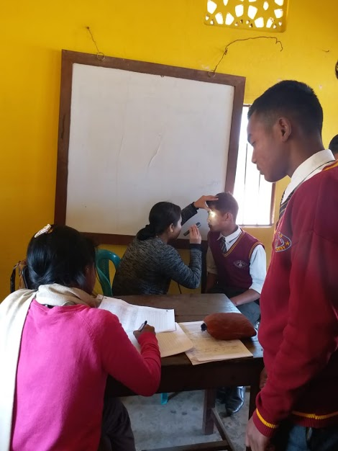
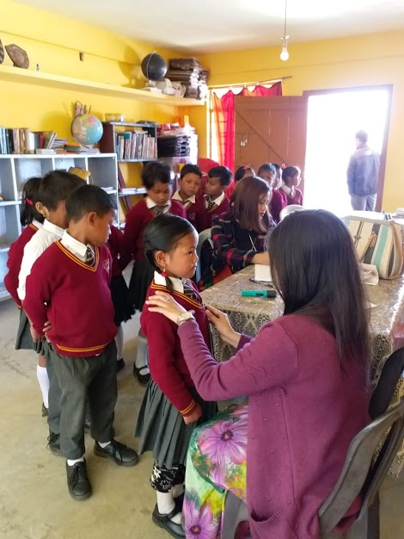

Slide 22
7. Toilet/Drinking Water
Government and Government Aided schools having Facilities
Total Schools Available | Boys Toilet* | Girls Toilet** | water | Hand Washing Facility
11597 | 10363 | 10008 | 11355 | 8576
Source: UDISE 2017-18

Slide 23
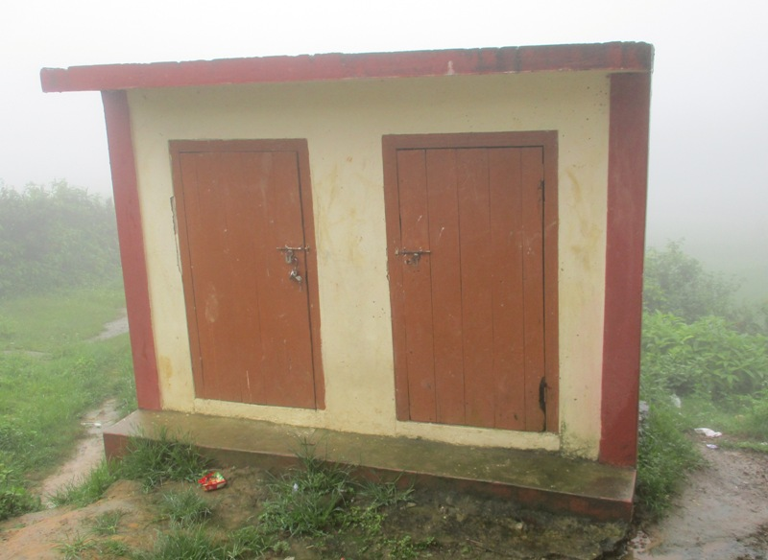
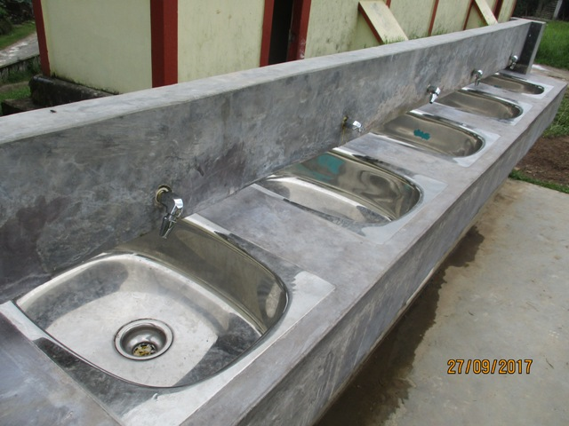

Slide 24
Proposal for 2018-19

Slide 25
Propose Institutions 2018-19
Sl. No. | Category | Schools |  | New Schools | Total of Schools Proposed to be Covered in 2018-19
 |  | No. Of Schools | No. Of Special Training Centers
1 | Primary | 7863 | 509 | 64 | 8436
2 | Upper Primary | 3257 | 151 | 3 | 3411
 | Total | 11120 | 660 | 67 | 11847
67 New School is proposed to be covered in 2018-19

Slide 26
Physical Targets for 2018-19
S. No | Component | Proposal for 2018-19
1 | Children (Pry) | 384583
2 | Children (U Pry) | 142408
Total Children |  | 526991
3 | Working Days (Primary & Up.Pry) | 200-Pry
 |  | 220-U.Pry
4 | Cook cum Helpers | 18547 (including 228 Addl.)
5 | Kitchen cum Store | NIL
6 | Kitchen Devices | 67 (New)
Notes:
26

Slide 27
Financial Requirements for 2018-19
Rs. In Lakhs
Recurring Central and State Assistance
Components | Central | State | Total
A) Recurring Assistance
Cost of Foodgain | 371.73 | 0 | 371.73
Cooking Cost | 4603.24 | 509.6 | 5112.84
Honorarium to Cook cum helper | 1669.23 | 185.47 | 1854.7
Transportation | 121.43 | 0 | 121.43
MME | 121.78 | 0 | 121.78
Total | 6887.41 | 695.07 | 7582.48
B) Non-Recurring Assistance
Kitchen-Sheds | 0 | 0 | 0
Kitchen Devices | 3.35 | 0 | 3.35
Total | 3.35 | 0 | 3.35
G. Total (A+B) | 6890.76 | 695.07 | 7585.83

Slide 28
Issues
Enhancement of Cooking Cost as per Price Index of Meghalaya.
Enhancement of Honorarium of Cook-Cum-Helpers as per Daily Wages Rate.
Increase of Management Fund from 1.8% to 4% out of Total Central Budget Cost so that at the State/District/Sub-Divisional/Blocks proper management and monitoring of the scheme be strengthening.
Funds for Kitchen sheds Replacement/Repairs /Store & Wash Room (Tentative Total Value is Rs.11635.30 Lakhs )
Replacement =Rs.4979.04 Lakhs (1353 units)
Repairs = Rs.19.84.80 (1654 Units)
Store Room & Wash Room = Rs.4671.76 (2539 Units)

Slide 29
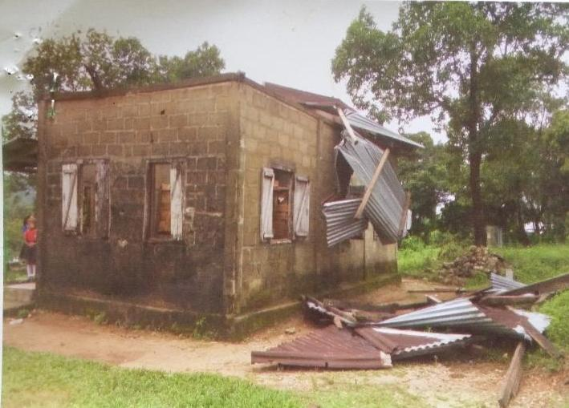
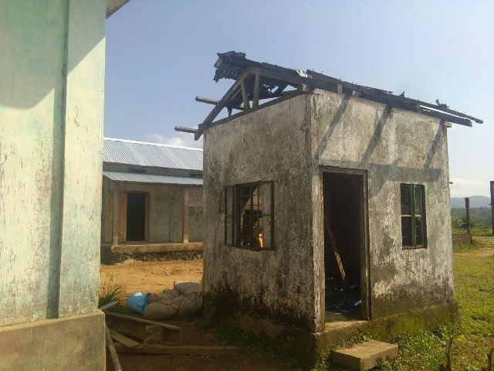
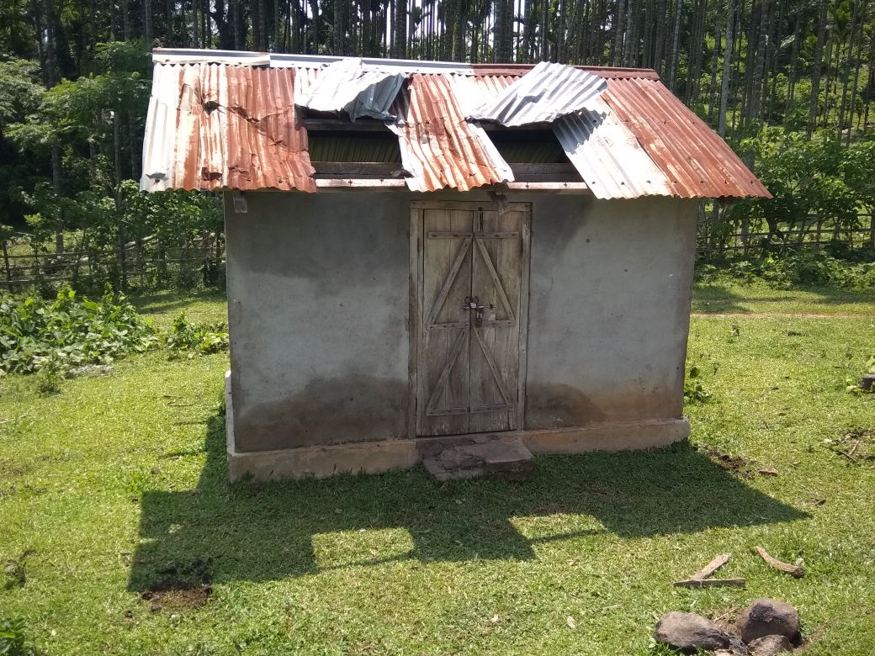
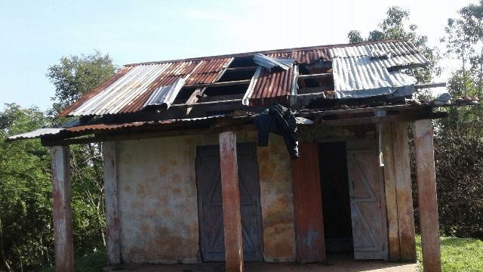

Slide 30
THANK YOU

